Slide 1
A New Breed of Cattle Feed

Slide 2
ProPell™
Evolved from
BalePlus™
Forage Injection Systems

Slide 3
BalePlus™
U.S. Patent: 6,126,985
Method, Composition and Apparatus
for Treating a Bale of Hay
www.baleplus.com
25+ years in successful business

Slide 4
We created a NEW Cattle Feed
ProPell™
Customizable livestock feed made from crushed, discarded sugarcane

Slide 5
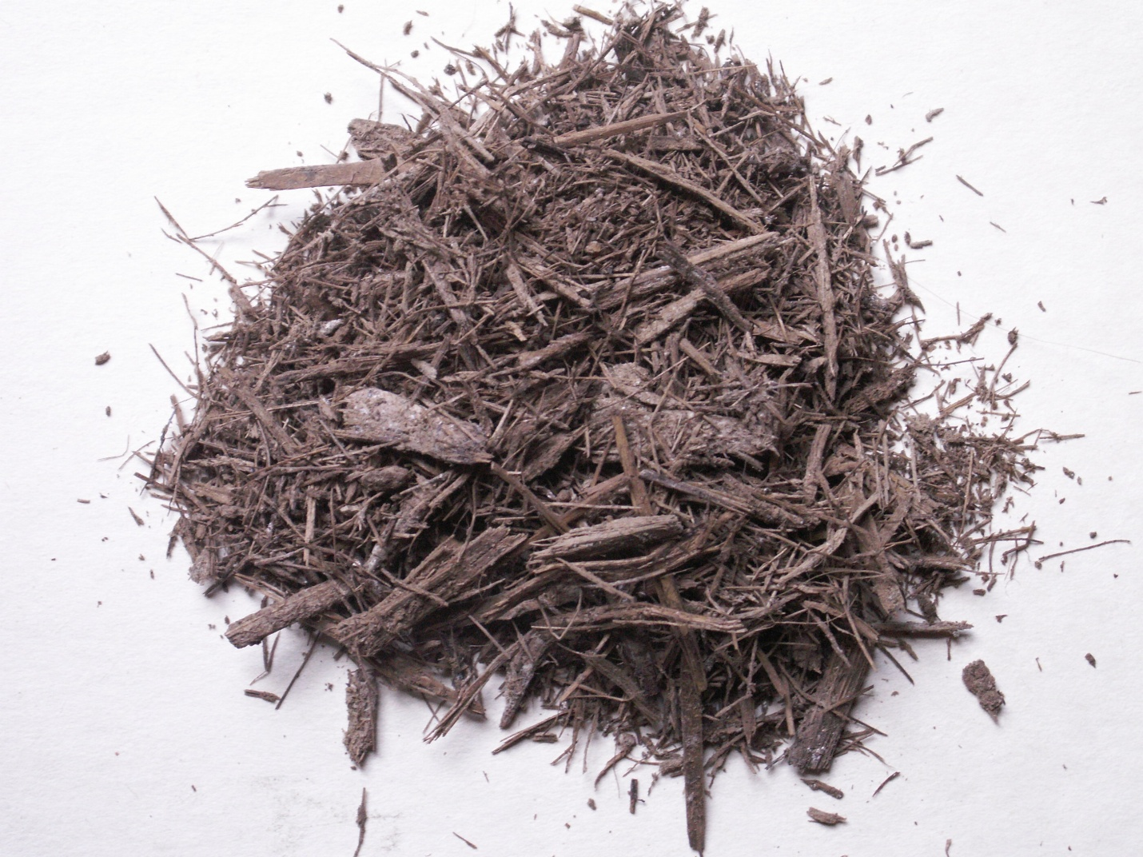
Raw Bagasse
Dried bagasse provides fiber for proper digestion

Slide 6
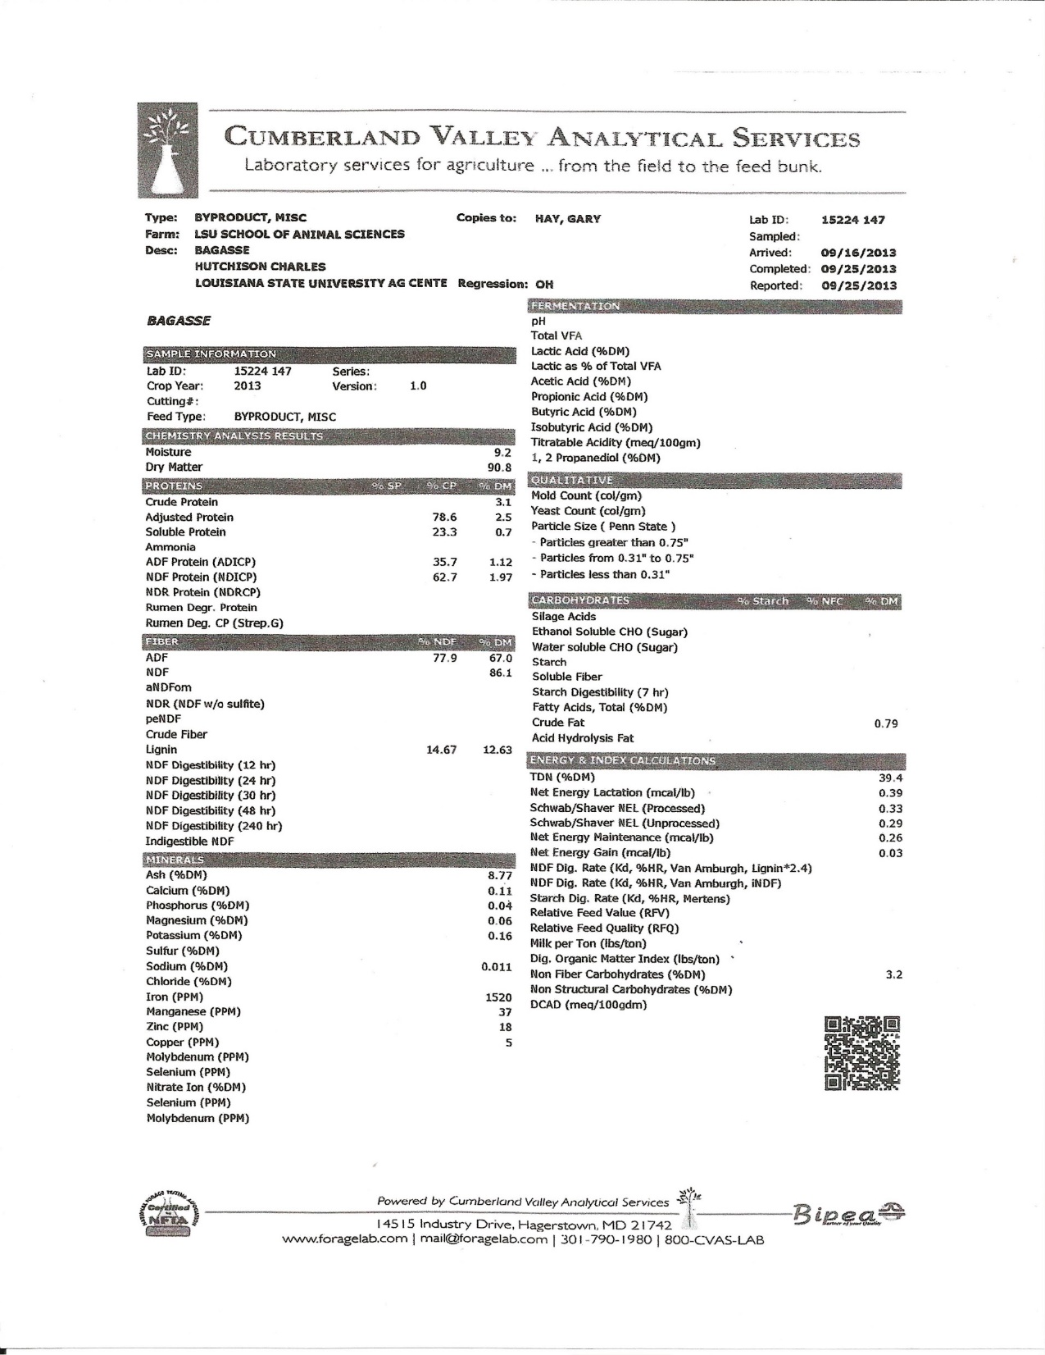

Slide 7
BalePlus™ Bio-technology
adapted to
ANM ProPell™ Cattle Feed

Slide 8
BalePlus™ StemCling™
Evolved into
ANM NutriCling™

Slide 9
ProPell™
Customizable Protein
Lower Cost

Slide 10
ProPell ™
High in Digestible Fiber
Stable and Abundant

Slide 11
ProPell™ Innovation
Bagasse is “poor” cattle feed by Itself, But
Bagasse is an excellent “carrier” of NutriCling™ Bagasse “roughage” contributes necessary fiber
NutriCling™ Contributes customized Nutrition
High Value, Low Cost Feed

Slide 12
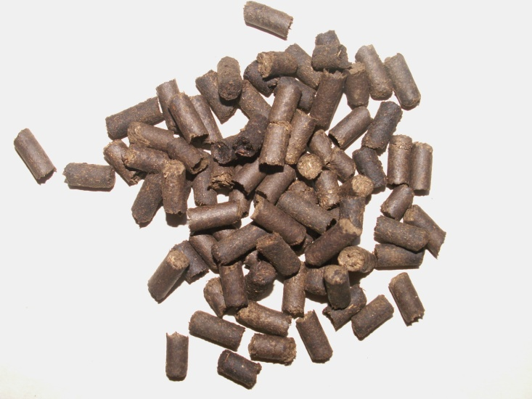
ProPell™ Livestock Feed Pellets
ProPell™ Cattle Feed Pellets
Made with ANM’s NutriCling™ and Bagasse

Slide 13
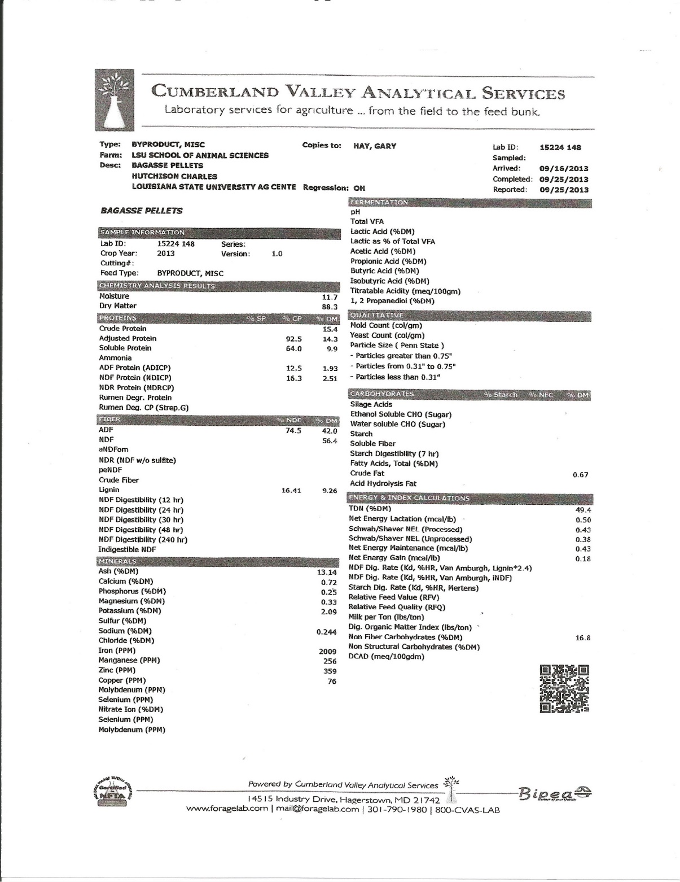

Slide 14
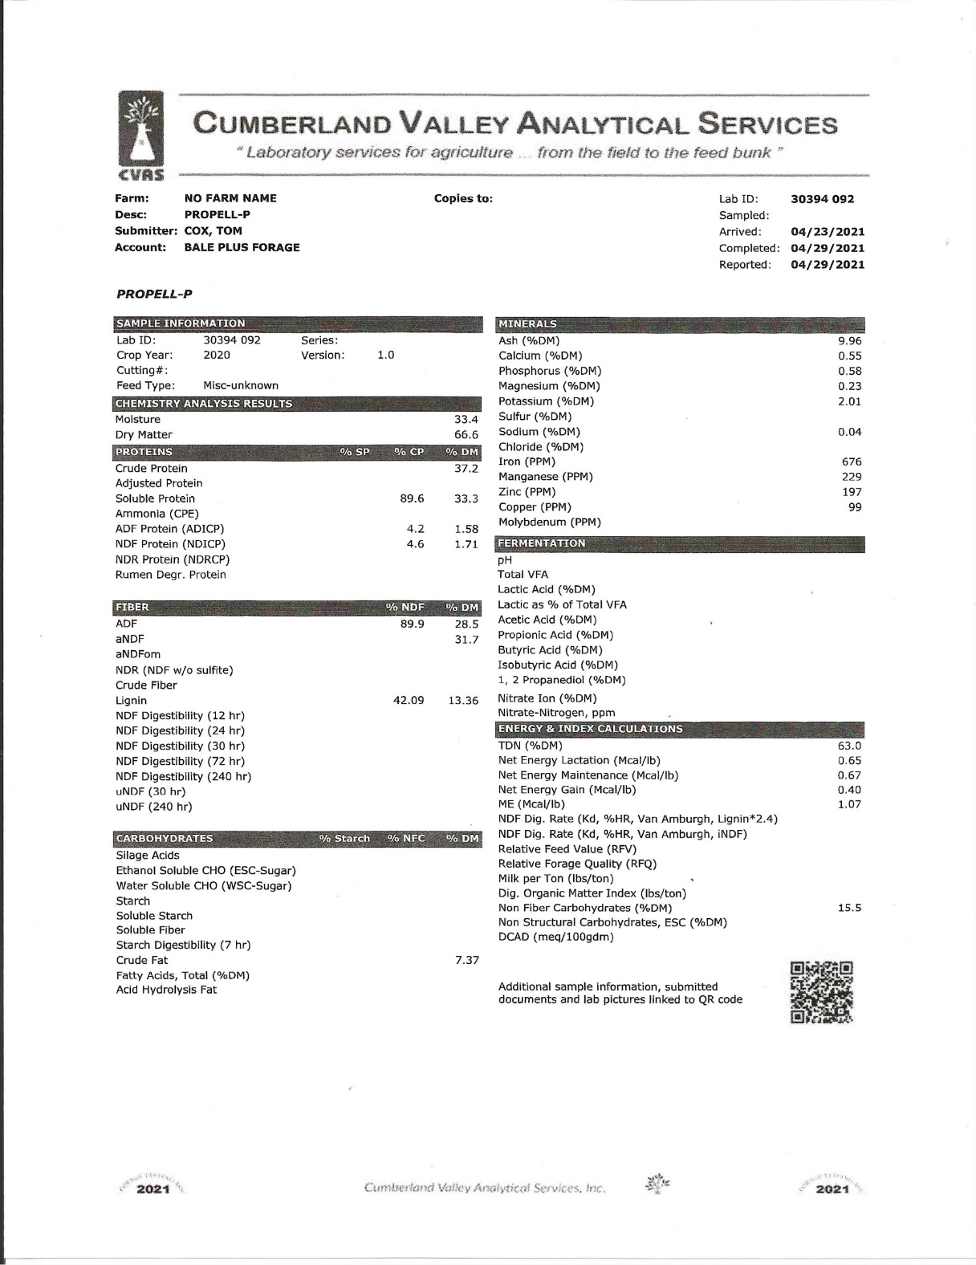

Slide 15
ProPell™
* Stable
* Customizable Protein
*Better TDN
* High Fiber
* Lower Priced

Slide 16
Cattle
ProPell™ Benefits
Abundant Supply
Customizable Nutrition
Balanced Ration
Lower Costs Compared to commodity feeds

Slide 17
ProPell™
ALWAYS BELOW
Commodity Traded Feed Costs

Slide 18
2020 Commodity Pricing versus ProPell™
Commodity feeds mix: Nutritionists aim for 15% Crude Protein
Soybean Meal = $319.32 /ton x .34 = $108.47
Corn Gluten Pellets = $196/ton x .66 = $129.36
Commodity Trading Price (15% Protein) = $237.93/ton*
ProPell™ Price (15% protein) priced $214.14/ton
(ProPell™ priced at $200/ton yields 40% Gross Profit)
* Prices appear as five year averages of commodity markets trades

Slide 19
July 2022 Commodity Pricing versus ProPell™
Commodity feeds mix: Nutritionists aim for 15% Crude Protein
Soybean Meal = $505 /ton x .34 = $171.70
Corn Gluten Pellets = $2.15/ton x .66 = $141.90
Commodity Trading Price (15% Protein) = $313.60/ton*
ProPell™ Price (15% protein) priced $214.14/ton

Slide 20
Commodity Pricing versus ProPell™
At July 2022 commodity benchmarks
ProPell™ is $100/ton Less
32% Savings

Slide 21
For More Information
Tom Cox
706 889 5990 cell
tcox@baleplus.com

